Slide 1

AdventureWorks
Group No: 6
Shraddha Wadnere
Tilak Bhutada
Bharatwaaj.RSM
Neela Sahithi
Madhumitha Manda
Bhumika Talware
Karegoud Indu Reddy

Slide 2
Project Overview
project involved analyzing the Adventure Works dataset using Excel, SQL, Power BI, and Tableau. The workflow covered data cleaning, querying, modeling, and visualization to uncover key business insights. The analysis highlighted important trends, performance metrics, and customer behavior, enabling data-driven recommendations and strategic decision-making.

Slide 3
Excel
Tools Used
Excel is crucial for data manipulation, enabling users to perform calculations, create pivot tables, and visualize data trends effectively. Its user-friendly interface supports extensive data analysis tasks.
Essential software for data analytics
Power BI
SQL
Tableau
Power BI enhances data visualization by transforming raw data into interactive dashboards and reports. It enables users to uncover insights through dynamic visual representations and real-time data analysis.
SQL is vital for querying databases, allowing users to extract, manipulate, and analyze datasets efficiently. It provides structured access to large volumes of data stored in relational databases.
Tableau is used to create interactive dashboards and visually present insights, helping to identify trends and patterns in the data clearly.

Slide 4
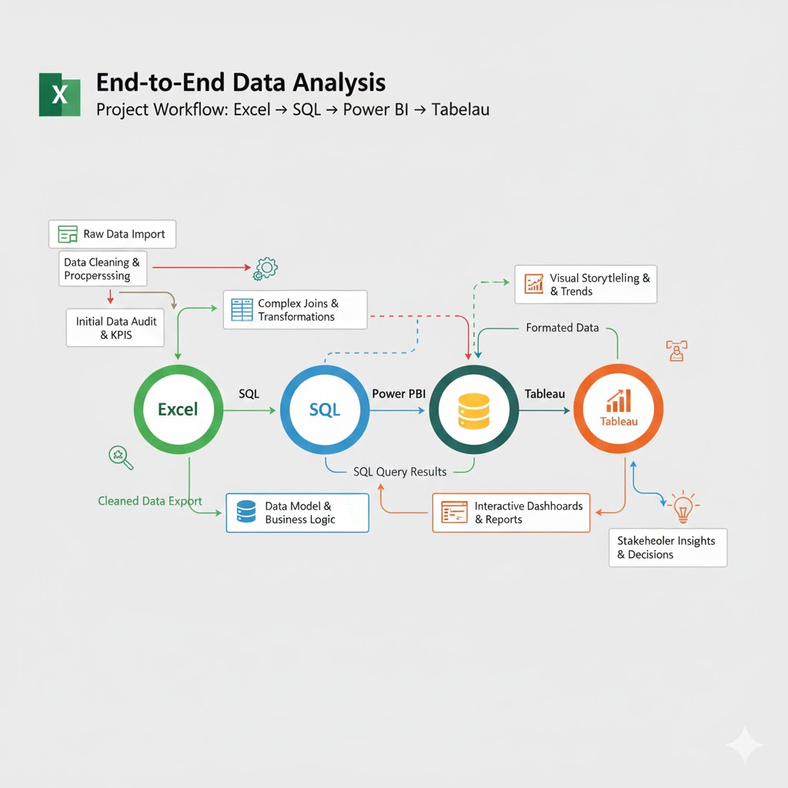
Data Workflow
Process Overview
This visual flow diagram illustrates the sequential steps of data analysis using the Adventure Works dataset, highlighting the transition from Excel to SQL, then Power BI, and finally Tableau.

Slide 5
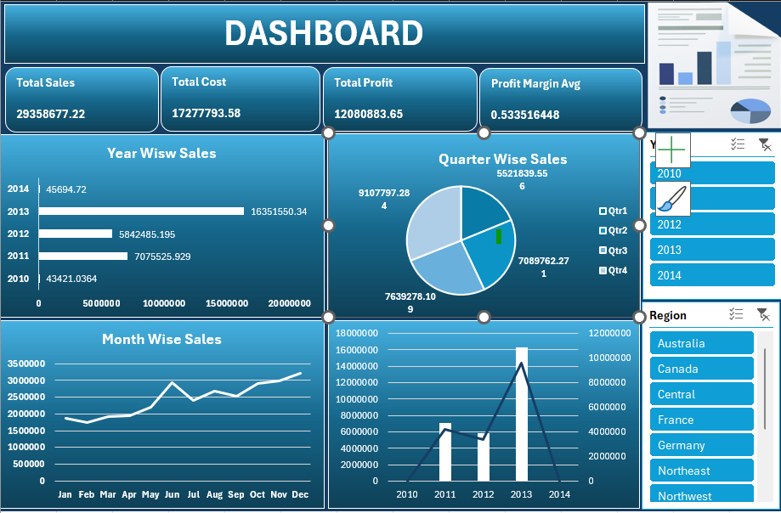
Excel Data Cleaning and Dashboard
Key Steps
The data cleaning process involved removing duplicates and ensuring proper formatting to maintain accuracy and integrity, preparing it for further analysis and visualization.

Slide 6
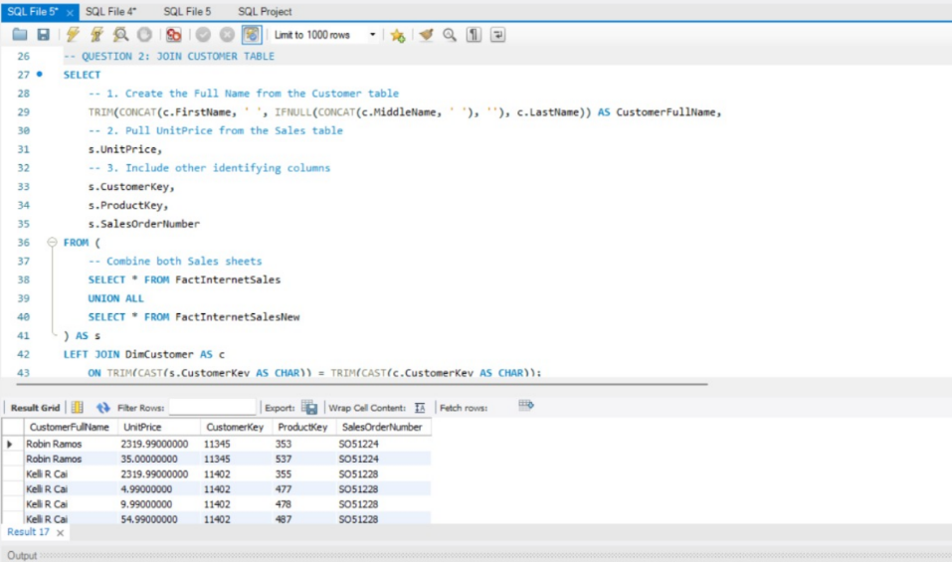
SQL Query
Analyzing data through SQL queries
Query Purpose
This SQL query is designed to extract specific data insights from the Adventure Works dataset, enabling effective analysis and visualization of key metrics that drive business decisions.

Slide 7
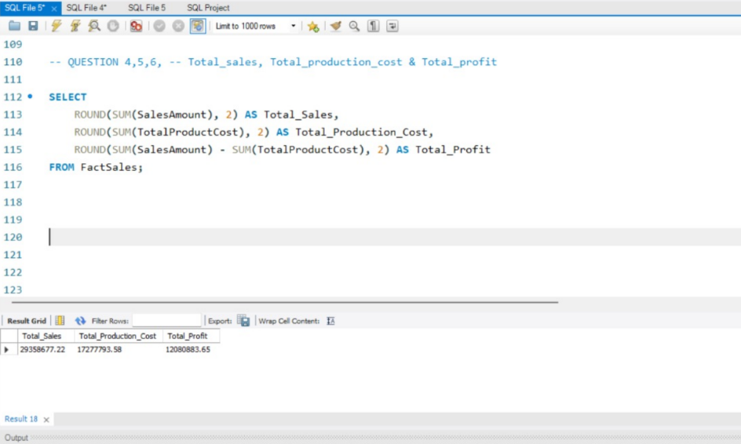
SQL Query

Slide 8
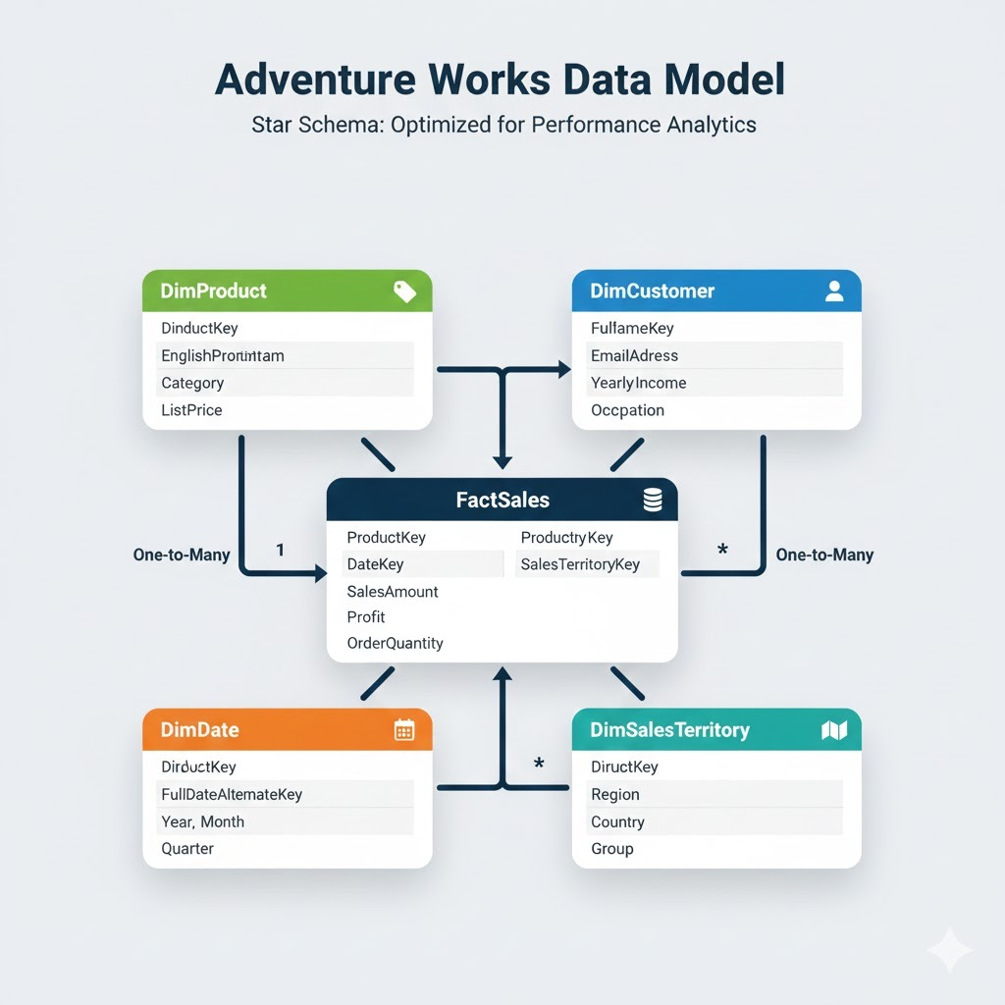
Power BI Data Model
Relationships Diagram
This diagram illustrates the data relationships within the Power BI model, showcasing how different datasets connect and interact for comprehensive analysis and reporting.

Slide 9
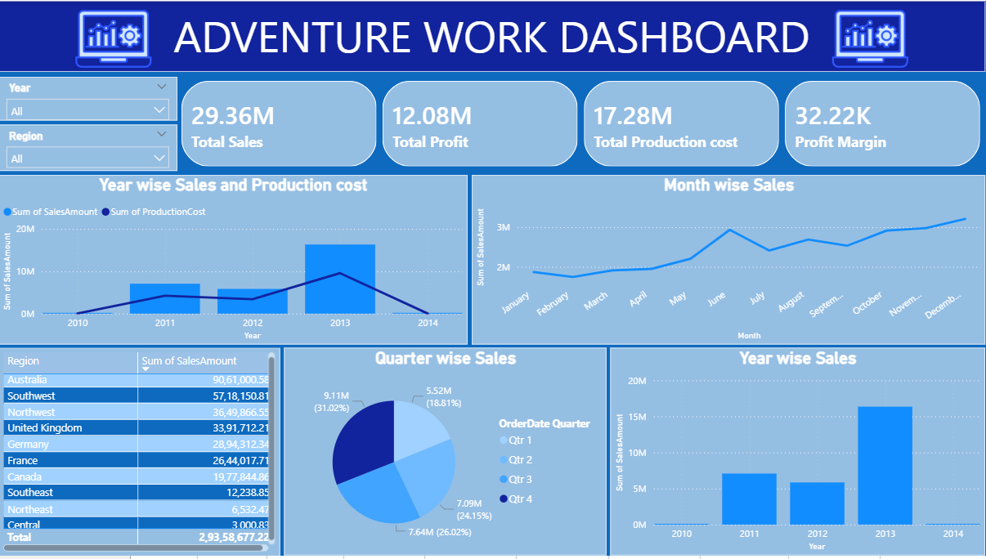
Power BI Dashboards
Key Metrics Displayed
This slide showcases the visual representation of key performance metrics, allowing for an insightful overview of data trends and analytics within the Adventure Works dataset.

Slide 10
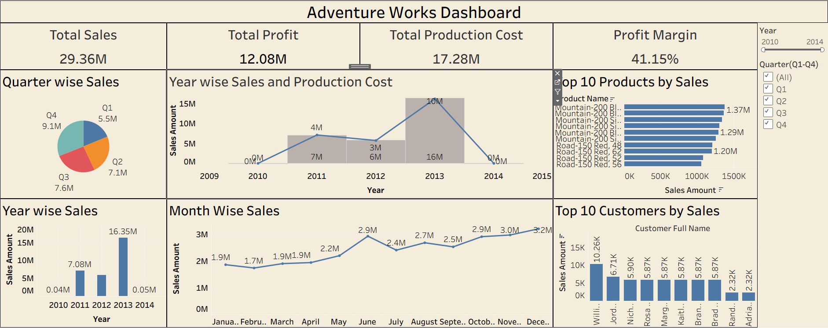
Tableau Visuals
Engaging Dashboard
This key dashboard highlights the various insights gathered from the Adventure Works dataset, showcasing dynamic visualizations including bar charts and geographical maps for better understanding.

Slide 11



Key Insights and Findings from Analysis
Data Trends
Significant patterns were observed in customer behavior.
Performance Metrics
Key metrics revealed important business growth areas.
Strategic Recommendations
Insights led to actionable strategies for improvement.

Slide 12



Key Learnings and Challenges Faced
Data Analysis
Developed skills in interpreting complex data sets effectively.
Problem Solving
Overcame challenges by applying critical thinking strategies.
Collaboration
Enhanced teamwork abilities through group project dynamics.

Slide 13

Conclusion
To conclude, this project helped in understanding how different data analytics tools work together to convert raw data into actionable insights. The use of KPIs and dashboards made it easier to analyze business performance and trends. This project strengthened both technical knowledge and analytical thinking, which are essential in today’s data-driven environment.

